Slide 1
CSCI 631 Foundations of Computer Vision
Ifeoma Nwogu
ion@cs.rit.edu

Slide 2
Schedule
Last class
Introduction
Today
Linear filters and convolution

Slide 3
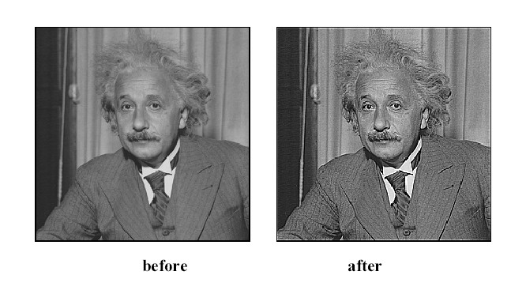

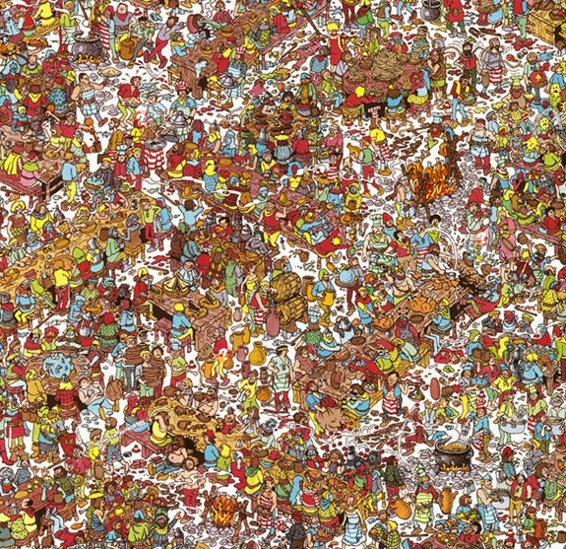
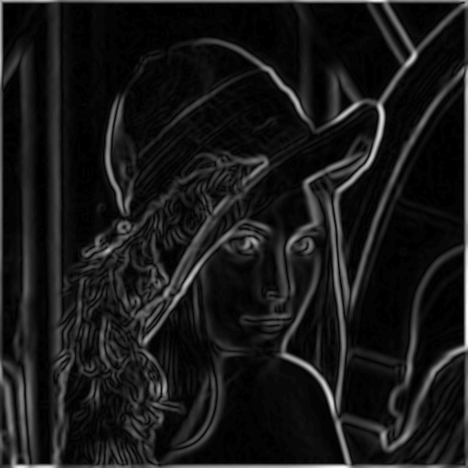
Image Filters
Smooth/Sharpen Images... Find edges... Find waldo…

Slide 4
Overview
Images as functions
Linear filters
Convolution and correlation

Slide 5
Overview
Images as functions
Linear filters
Convolution and correlation

Slide 6
Images as functions
We can think of an image as a function, f, from R² to R:
f( x, y ) gives the intensity at position ( x, y )
Realistically, we expect the image only to be defined over a rectangle, with a finite range:
f: [a,b] x [c,d] → [0, 1.0]
A color image is just three functions pasted together. We can write this as a “vector-valued” function:
Source: S. Seitz

Slide 7
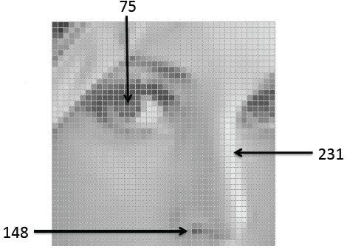
Images as functions
An image contains discrete number of pixels, e.g.
“grayscale” (or “intensity”): [0,255]
Source: F.F Lei

Slide 8
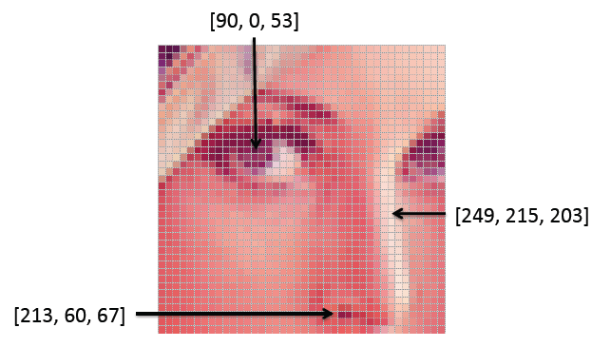
Images as functions
An image contains discrete number of pixels, e.g.
“grayscale” (or “intensity”): [0,255]
Color
RGB: [R, G, B]
Lab: [L, a, b]
HSV: [H, S, V]
Source: F.F Lei

Slide 9
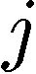
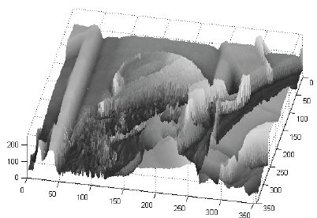
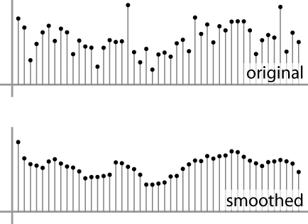
Images as discrete functions
In computer vision we operate on digital (discrete) images:
Sample the 2D space on a regular grid
Quantize each sample (round to nearest integer)
Image thus represented as a matrix of integer values.
2D
1D

Slide 10
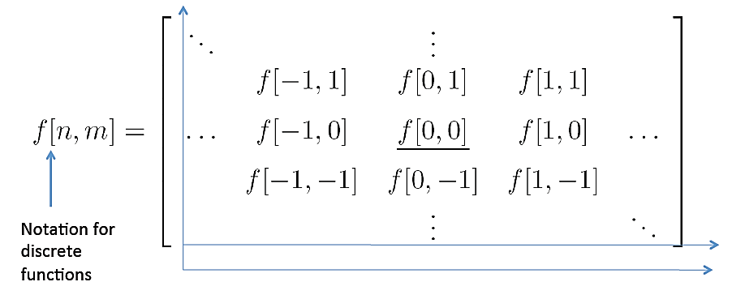
Images as discrete functions
Cartesian coordinates

Slide 11
Overview
Images as functions
Linear filters
Convolution and correlation

Slide 12
Motivation
Filtering:
Form a new image whose pixels are a combination original pixel values
Goals:
Extract useful information from the images
Features (edges, corners, blobs…)
Modify or enhance image properties:
super-­resolution; in-painting; de­‐noising

Slide 13
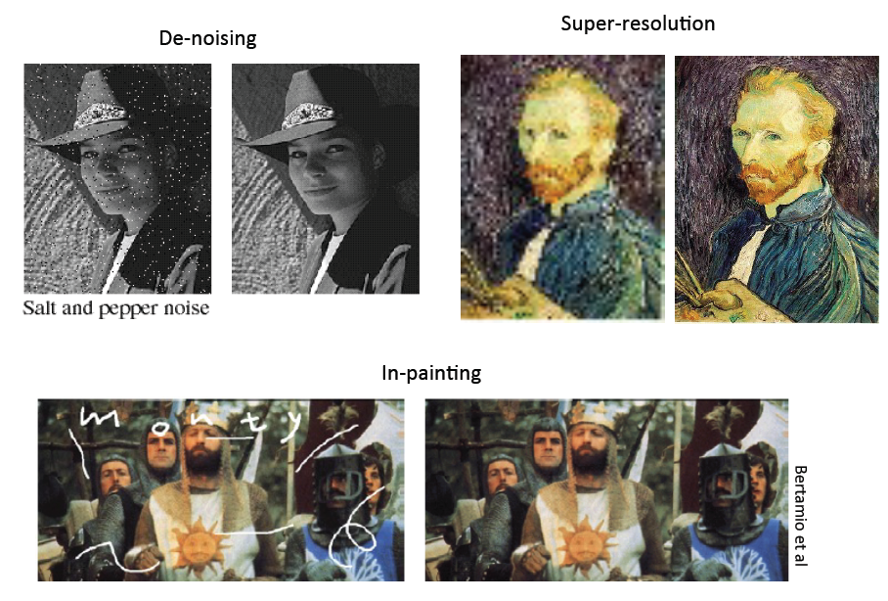
Source: F.F. Li

Slide 14
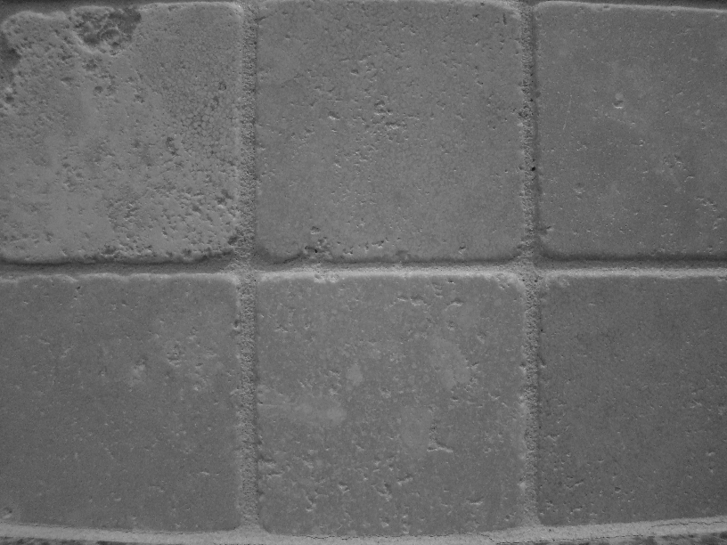
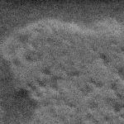
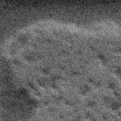

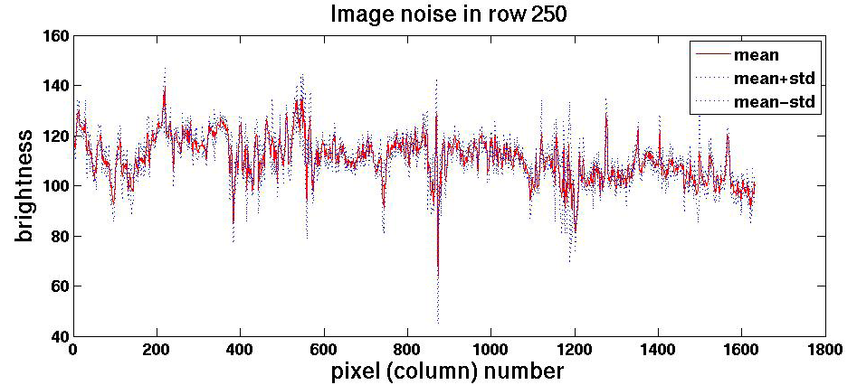
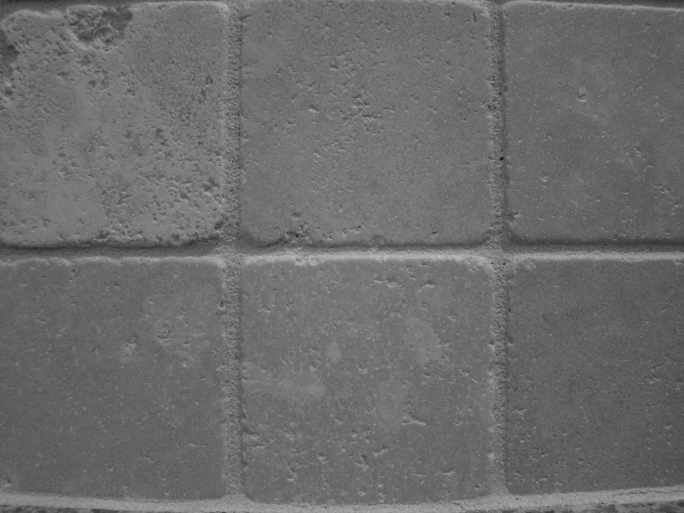
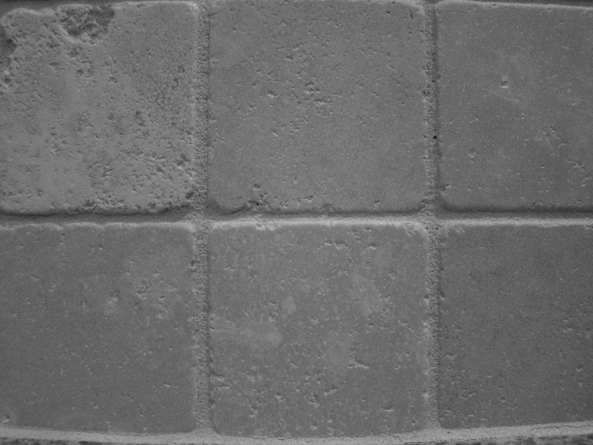


Motivation: noise reduction
We can measure noise in multiple images of the same static scene.
How could we reduce the noise, i.e., give an estimate of the true intensities?
What if there’s only one image?

Slide 15
Common types of noise
Salt and pepper noise: random occurrences of black and white pixels
Impulse noise: random occurrences of white pixels
Gaussian noise: variations in intensity drawn from a Gaussian normal distribution
Source: S. Seitz

Slide 16
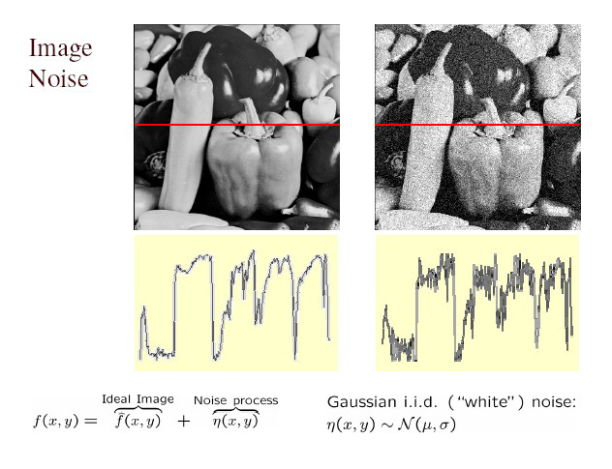
Gaussian noise
>> noise = randn(size(im)).*sigma;
>> output = im + noise;
Fig: M. Hebert

Slide 17
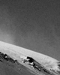
Effect of sigma on Gaussian noise:
This shows the noise values added to the raw intensities of an image.
sigma=1

Slide 18
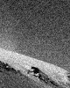
Effect of sigma on Gaussian noise
This shows the noise values added to the raw intensities of an image.
sigma=16

Slide 19
First attempt at a solution
Let’s replace each pixel with an average of all the values in its neighborhood
Assumptions:
Expect pixels to be like their neighbors
Expect noise processes to be independent from pixel to pixel

Slide 20
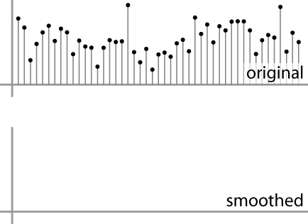
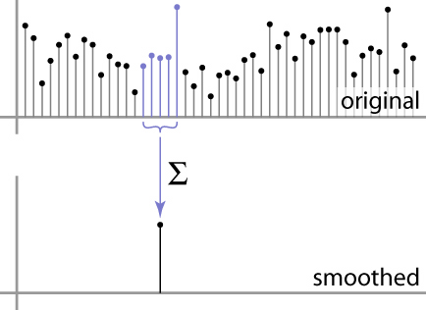
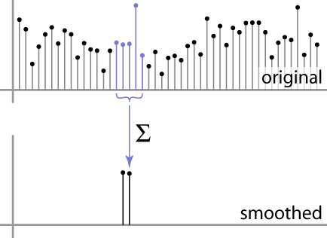
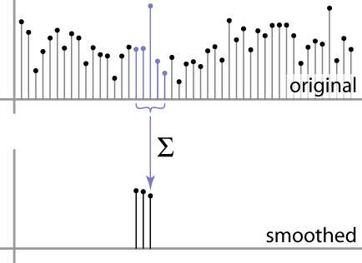
First attempt at a solution
Let’s replace each pixel with an average of all the values in its neighborhood
Moving average in 1D:
Source: S. Marschner

Slide 21
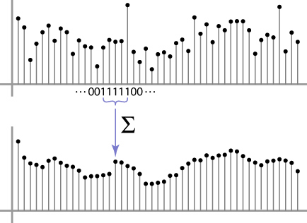
Weighted Moving Average
Can add weights to our moving average
Weights [1, 1, 1, 1, 1] / 5
Source: S. Marschner

Slide 22

Weighted Moving Average
Non-uniform weights [1, 4, 6, 4, 1] / 16
Source: S. Marschner

Slide 23
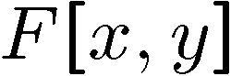
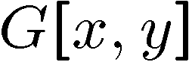
Moving Average In 2D
0 | 0 | 0 | 0 | 0 | 0 | 0 | 0 | 0 | 0
0 | 0 | 0 | 0 | 0 | 0 | 0 | 0 | 0 | 0
0 | 0 | 0 | 90 | 90 | 90 | 90 | 90 | 0 | 0
0 | 0 | 0 | 90 | 90 | 90 | 90 | 90 | 0 | 0
0 | 0 | 0 | 90 | 90 | 90 | 90 | 90 | 0 | 0
0 | 0 | 0 | 90 | 0 | 90 | 90 | 90 | 0 | 0
0 | 0 | 0 | 90 | 90 | 90 | 90 | 90 | 0 | 0
0 | 0 | 0 | 0 | 0 | 0 | 0 | 0 | 0 | 0
0 | 0 | 90 | 0 | 0 | 0 | 0 | 0 | 0 | 0
0 | 0 | 0 | 0 | 0 | 0 | 0 | 0 | 0 | 0
 | 0
0 | 0 | 0 | 0 | 0 | 0 | 0 | 0 | 0 | 0
0 | 0 | 0 | 0 | 0 | 0 | 0 | 0 | 0 | 0
0 | 0 | 0 | 90 | 90 | 90 | 90 | 90 | 0 | 0
0 | 0 | 0 | 90 | 90 | 90 | 90 | 90 | 0 | 0
0 | 0 | 0 | 90 | 90 | 90 | 90 | 90 | 0 | 0
0 | 0 | 0 | 90 | 0 | 90 | 90 | 90 | 0 | 0
0 | 0 | 0 | 90 | 90 | 90 | 90 | 90 | 0 | 0
0 | 0 | 0 | 0 | 0 | 0 | 0 | 0 | 0 | 0
0 | 0 | 90 | 0 | 0 | 0 | 0 | 0 | 0 | 0
0 | 0 | 0 | 0 | 0 | 0 | 0 | 0 | 0 | 0
Source: S. Seitz
Notes:
ones, divide by 9

Slide 24
Moving Average In 2D
0 | 0 | 0 | 0 | 0 | 0 | 0 | 0 | 0 | 0
0 | 0 | 0 | 0 | 0 | 0 | 0 | 0 | 0 | 0
0 | 0 | 0 | 90 | 90 | 90 | 90 | 90 | 0 | 0
0 | 0 | 0 | 90 | 90 | 90 | 90 | 90 | 0 | 0
0 | 0 | 0 | 90 | 90 | 90 | 90 | 90 | 0 | 0
0 | 0 | 0 | 90 | 0 | 90 | 90 | 90 | 0 | 0
0 | 0 | 0 | 90 | 90 | 90 | 90 | 90 | 0 | 0
0 | 0 | 0 | 0 | 0 | 0 | 0 | 0 | 0 | 0
0 | 0 | 90 | 0 | 0 | 0 | 0 | 0 | 0 | 0
0 | 0 | 0 | 0 | 0 | 0 | 0 | 0 | 0 | 0
 | 0 | 10
0 | 0 | 0 | 0 | 0 | 0 | 0 | 0 | 0 | 0
0 | 0 | 0 | 0 | 0 | 0 | 0 | 0 | 0 | 0
0 | 0 | 0 | 90 | 90 | 90 | 90 | 90 | 0 | 0
0 | 0 | 0 | 90 | 90 | 90 | 90 | 90 | 0 | 0
0 | 0 | 0 | 90 | 90 | 90 | 90 | 90 | 0 | 0
0 | 0 | 0 | 90 | 0 | 90 | 90 | 90 | 0 | 0
0 | 0 | 0 | 90 | 90 | 90 | 90 | 90 | 0 | 0
0 | 0 | 0 | 0 | 0 | 0 | 0 | 0 | 0 | 0
0 | 0 | 90 | 0 | 0 | 0 | 0 | 0 | 0 | 0
0 | 0 | 0 | 0 | 0 | 0 | 0 | 0 | 0 | 0
Source: S. Seitz
Notes:
ones, divide by 9

Slide 25
Moving Average In 2D
0 | 0 | 0 | 0 | 0 | 0 | 0 | 0 | 0 | 0
0 | 0 | 0 | 0 | 0 | 0 | 0 | 0 | 0 | 0
0 | 0 | 0 | 90 | 90 | 90 | 90 | 90 | 0 | 0
0 | 0 | 0 | 90 | 90 | 90 | 90 | 90 | 0 | 0
0 | 0 | 0 | 90 | 90 | 90 | 90 | 90 | 0 | 0
0 | 0 | 0 | 90 | 0 | 90 | 90 | 90 | 0 | 0
0 | 0 | 0 | 90 | 90 | 90 | 90 | 90 | 0 | 0
0 | 0 | 0 | 0 | 0 | 0 | 0 | 0 | 0 | 0
0 | 0 | 90 | 0 | 0 | 0 | 0 | 0 | 0 | 0
0 | 0 | 0 | 0 | 0 | 0 | 0 | 0 | 0 | 0
 | 0 | 10 | 20
0 | 0 | 0 | 0 | 0 | 0 | 0 | 0 | 0 | 0
0 | 0 | 0 | 0 | 0 | 0 | 0 | 0 | 0 | 0
0 | 0 | 0 | 90 | 90 | 90 | 90 | 90 | 0 | 0
0 | 0 | 0 | 90 | 90 | 90 | 90 | 90 | 0 | 0
0 | 0 | 0 | 90 | 90 | 90 | 90 | 90 | 0 | 0
0 | 0 | 0 | 90 | 0 | 90 | 90 | 90 | 0 | 0
0 | 0 | 0 | 90 | 90 | 90 | 90 | 90 | 0 | 0
0 | 0 | 0 | 0 | 0 | 0 | 0 | 0 | 0 | 0
0 | 0 | 90 | 0 | 0 | 0 | 0 | 0 | 0 | 0
0 | 0 | 0 | 0 | 0 | 0 | 0 | 0 | 0 | 0
Source: S. Seitz
Notes:
ones, divide by 9

Slide 26
Moving Average In 2D
0 | 0 | 0 | 0 | 0 | 0 | 0 | 0 | 0 | 0
0 | 0 | 0 | 0 | 0 | 0 | 0 | 0 | 0 | 0
0 | 0 | 0 | 90 | 90 | 90 | 90 | 90 | 0 | 0
0 | 0 | 0 | 90 | 90 | 90 | 90 | 90 | 0 | 0
0 | 0 | 0 | 90 | 90 | 90 | 90 | 90 | 0 | 0
0 | 0 | 0 | 90 | 0 | 90 | 90 | 90 | 0 | 0
0 | 0 | 0 | 90 | 90 | 90 | 90 | 90 | 0 | 0
0 | 0 | 0 | 0 | 0 | 0 | 0 | 0 | 0 | 0
0 | 0 | 90 | 0 | 0 | 0 | 0 | 0 | 0 | 0
0 | 0 | 0 | 0 | 0 | 0 | 0 | 0 | 0 | 0
 | 0 | 10 | 20 | 30
0 | 0 | 0 | 0 | 0 | 0 | 0 | 0 | 0 | 0
0 | 0 | 0 | 0 | 0 | 0 | 0 | 0 | 0 | 0
0 | 0 | 0 | 90 | 90 | 90 | 90 | 90 | 0 | 0
0 | 0 | 0 | 90 | 90 | 90 | 90 | 90 | 0 | 0
0 | 0 | 0 | 90 | 90 | 90 | 90 | 90 | 0 | 0
0 | 0 | 0 | 90 | 0 | 90 | 90 | 90 | 0 | 0
0 | 0 | 0 | 90 | 90 | 90 | 90 | 90 | 0 | 0
0 | 0 | 0 | 0 | 0 | 0 | 0 | 0 | 0 | 0
0 | 0 | 90 | 0 | 0 | 0 | 0 | 0 | 0 | 0
0 | 0 | 0 | 0 | 0 | 0 | 0 | 0 | 0 | 0
Source: S. Seitz
Notes:
ones, divide by 9

Slide 27
Moving Average In 2D
0 | 0 | 0 | 0 | 0 | 0 | 0 | 0 | 0 | 0
0 | 0 | 0 | 0 | 0 | 0 | 0 | 0 | 0 | 0
0 | 0 | 0 | 90 | 90 | 90 | 90 | 90 | 0 | 0
0 | 0 | 0 | 90 | 90 | 90 | 90 | 90 | 0 | 0
0 | 0 | 0 | 90 | 90 | 90 | 90 | 90 | 0 | 0
0 | 0 | 0 | 90 | 0 | 90 | 90 | 90 | 0 | 0
0 | 0 | 0 | 90 | 90 | 90 | 90 | 90 | 0 | 0
0 | 0 | 0 | 0 | 0 | 0 | 0 | 0 | 0 | 0
0 | 0 | 90 | 0 | 0 | 0 | 0 | 0 | 0 | 0
0 | 0 | 0 | 0 | 0 | 0 | 0 | 0 | 0 | 0
 | 0 | 10 | 20 | 30 | 30
Source: S. Seitz
Notes:
ones, divide by 9

Slide 28
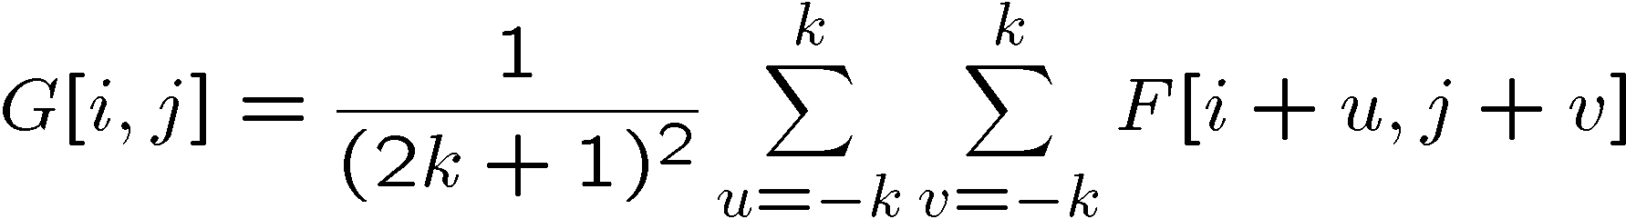
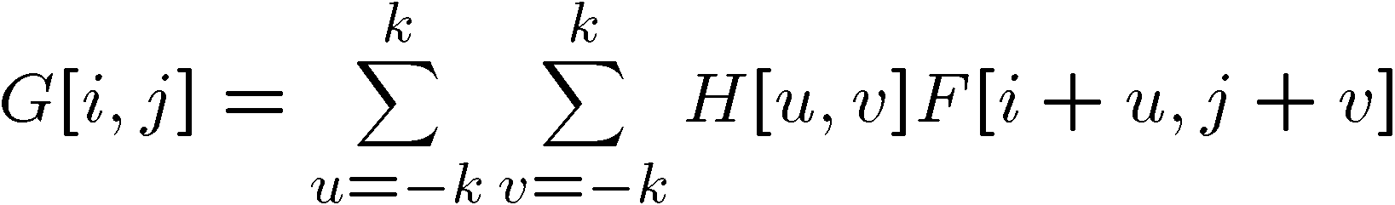
Correlation filtering
Say the averaging window size is 2k+1 x 2k+1:
Attribute uniform weight to each pixel
Loop over all pixels in neighborhood around image pixel F[i,j]
Now generalize to allow different weights depending on neighboring pixel’s relative position:
Non-uniform weights

Slide 29
Moving Average In 2D
0 | 0 | 0 | 0 | 0 | 0 | 0 | 0 | 0 | 0
0 | 0 | 0 | 0 | 0 | 0 | 0 | 0 | 0 | 0
0 | 0 | 0 | 90 | 90 | 90 | 90 | 90 | 0 | 0
0 | 0 | 0 | 90 | 90 | 90 | 90 | 90 | 0 | 0
0 | 0 | 0 | 90 | 90 | 90 | 90 | 90 | 0 | 0
0 | 0 | 0 | 90 | 0 | 90 | 90 | 90 | 0 | 0
0 | 0 | 0 | 90 | 90 | 90 | 90 | 90 | 0 | 0
0 | 0 | 0 | 0 | 0 | 0 | 0 | 0 | 0 | 0
0 | 0 | 90 | 0 | 0 | 0 | 0 | 0 | 0 | 0
0 | 0 | 0 | 0 | 0 | 0 | 0 | 0 | 0 | 0
 | 0 | 10 | 20 | 30 | 30 | 30 | 20 | 10
 | 0 | 20 | 40 | 60 | 60 | 60 | 40 | 20
 | 0 | 30 | 60 | 90 | 90 | 90 | 60 | 30
 | 0 | 30 | 50 | 80 | 80 | 90 | 60 | 30
 | 0 | 30 | 50 | 80 | 80 | 90 | 60 | 30
 | 0 | 20 | 30 | 50 | 50 | 60 | 40 | 20
 | 10 | 20 | 30 | 30 | 30 | 30 | 20 | 10
 | 10 | 10 | 10 | 0 | 0 | 0 | 0 | 0
Source: S. Seitz
Notes:
ones, divide by 9

Slide 30
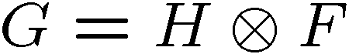
Correlation filtering
This is called cross-correlation, denoted
Filtering an image: replace each pixel with a linear combination of its neighbors.
The filter “kernel” or “mask” H[u,v] is the prescription for the weights in the linear combination.

Slide 31
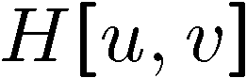

Averaging filter
What values belong in the kernel H for the moving average example?
0 | 0 | 0 | 0 | 0 | 0 | 0 | 0 | 0 | 0
0 | 0 | 0 | 0 | 0 | 0 | 0 | 0 | 0 | 0
0 | 0 | 0 | 90 | 90 | 90 | 90 | 90 | 0 | 0
0 | 0 | 0 | 90 | 90 | 90 | 90 | 90 | 0 | 0
0 | 0 | 0 | 90 | 90 | 90 | 90 | 90 | 0 | 0
0 | 0 | 0 | 90 | 0 | 90 | 90 | 90 | 0 | 0
0 | 0 | 0 | 90 | 90 | 90 | 90 | 90 | 0 | 0
0 | 0 | 0 | 0 | 0 | 0 | 0 | 0 | 0 | 0
0 | 0 | 90 | 0 | 0 | 0 | 0 | 0 | 0 | 0
0 | 0 | 0 | 0 | 0 | 0 | 0 | 0 | 0 | 0
 | 0 | 10 | 20 | 30 | 30
1
1
1
1
?
1
1
1
1
1
“box filter”

Slide 32
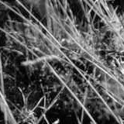
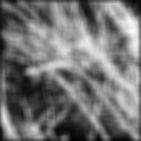
Smoothing by averaging
original
filtered

Slide 33
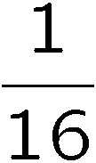
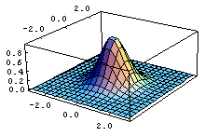
Gaussian filter
What if we want nearest neighboring pixels to have the most influence on the output?
This kernel is an approximation of a Gaussian function:
0 | 0 | 0 | 0 | 0 | 0 | 0 | 0 | 0 | 0
0 | 0 | 0 | 0 | 0 | 0 | 0 | 0 | 0 | 0
0 | 0 | 0 | 90 | 90 | 90 | 90 | 90 | 0 | 0
0 | 0 | 0 | 90 | 90 | 90 | 90 | 90 | 0 | 0
0 | 0 | 0 | 90 | 90 | 90 | 90 | 90 | 0 | 0
0 | 0 | 0 | 90 | 0 | 90 | 90 | 90 | 0 | 0
0 | 0 | 0 | 90 | 90 | 90 | 90 | 90 | 0 | 0
0 | 0 | 0 | 0 | 0 | 0 | 0 | 0 | 0 | 0
0 | 0 | 90 | 0 | 0 | 0 | 0 | 0 | 0 | 0
0 | 0 | 0 | 0 | 0 | 0 | 0 | 0 | 0 | 0
1 | 2 | 1
2 | 4 | 2
1 | 2 | 1
Source: S. Seitz

Slide 34

Smoothing with a Gaussian

Slide 35
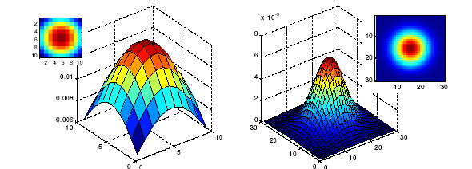
Gaussian filters
What parameters matter here?
Size of kernel or mask
Note, Gaussian function has infinite support, but discrete filters use finite kernels
σ = 5 with
10 x 10 kernel
σ = 5 with
30 x 30 kernel

Slide 36
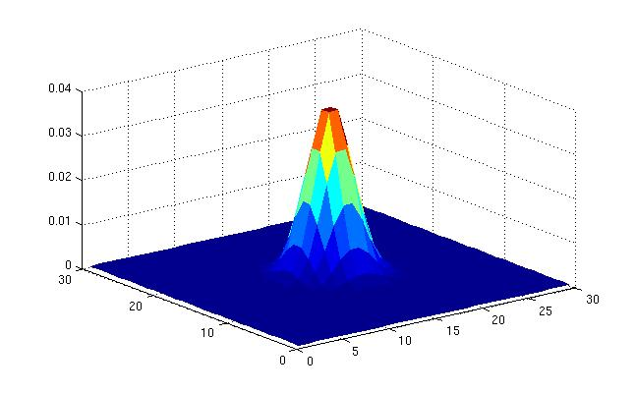
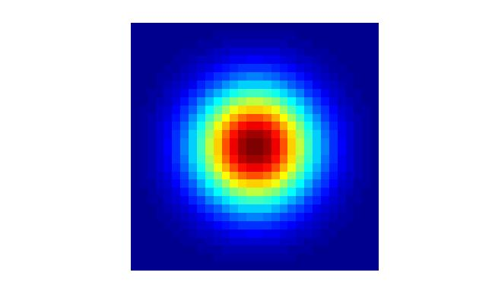
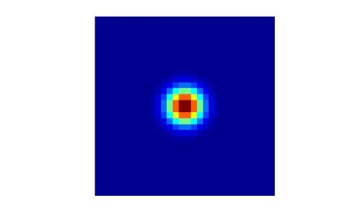
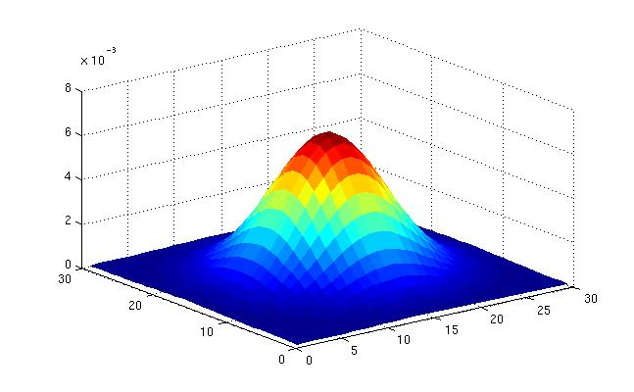
Gaussian filters
What parameters matter here?
Variance of Gaussian: determines extent of smoothing
σ = 2 with
30 x 30 kernel
σ = 5 with
30 x 30 kernel

Slide 37
Boundary issues
What is the size of the output?
shape = ‘full’: output size is sum of sizes of f and g
shape = ‘same’: output size is same as f
shape = ‘valid’: output size is difference of sizes of f and g
full
same
valid
g
g
g
g
f
f
f
g
g
g
g
g
g
g
g
Source: S. Lazebnik

Slide 38













Boundary issues
What about near the edge?
the filter window falls off the edge of the image
need to extrapolate
methods:
clip filter (black)
wrap around
copy edge
reflect across edge
Source: S. Marschner

Slide 39
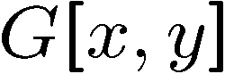
Filtering an impulse signal
What is the result of filtering the impulse signal (image) F with the arbitrary kernel H?
0 | 0 | 0 | 0 | 0 | 0 | 0
0 | 0 | 0 | 0 | 0 | 0 | 0
0 | 0 | 0 | 0 | 0 | 0 | 0
0 | 0 | 0 | 1 | 0 | 0 | 0
0 | 0 | 0 | 0 | 0 | 0 | 0
0 | 0 | 0 | 0 | 0 | 0 | 0
0 | 0 | 0 | 0 | 0 | 0 | 0
a | b | c
d | e | f
g | h | i
?

Slide 40
Filtering an impulse signal (correlation)
What is the result of filtering the impulse signal (image) F with the arbitrary kernel H?
0 | 0 | 0 | 0 | 0 | 0 | 0
0 | 0 | 0 | 0 | 0 | 0 | 0
0 | 0 | 0 | 0 | 0 | 0 | 0
0 | 0 | 0 | 1 | 0 | 0 | 0
0 | 0 | 0 | 0 | 0 | 0 | 0
0 | 0 | 0 | 0 | 0 | 0 | 0
0 | 0 | 0 | 0 | 0 | 0 | 0
0 | 0 | 0 | 0 | 0 | 0 | 0
0 | 0 | 0 | 0 | 0 | 0 | 0
0 | 0 | 0 | 0 | 0 | 0 | 0
0 | 0 | 0 | 1 | 0 | 0 | 0
0 | 0 | 0 | 0 | 0 | 0 | 0
0 | 0 | 0 | 0 | 0 | 0 | 0
0 | 0 | 0 | 0 | 0 | 0 | 0
a | b | c
d | e | f
g | h | i
i | h | g
f | e | d
c | b | a

Slide 41
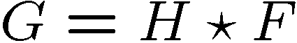
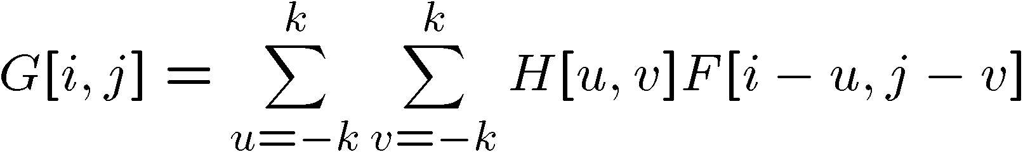
Filtering an impulse signal (convolution)
What is the result of filtering the impulse signal (image) F with the arbitrary kernel H?
0 | 0 | 0 | 0 | 0 | 0 | 0
0 | 0 | 0 | 0 | 0 | 0 | 0
0 | 0 | 0 | 0 | 0 | 0 | 0
0 | 0 | 0 | 1 | 0 | 0 | 0
0 | 0 | 0 | 0 | 0 | 0 | 0
0 | 0 | 0 | 0 | 0 | 0 | 0
0 | 0 | 0 | 0 | 0 | 0 | 0
0 | 0 | 0 | 0 | 0 | 0 | 0
0 | 0 | 0 | 0 | 0 | 0 | 0
0 | 0 | 0 | 0 | 0 | 0 | 0
0 | 0 | 0 | 1 | 0 | 0 | 0
0 | 0 | 0 | 0 | 0 | 0 | 0
0 | 0 | 0 | 0 | 0 | 0 | 0
0 | 0 | 0 | 0 | 0 | 0 | 0
a | b | c
d | e | f
g | h | i
a | b | c
d | e | f
g | h | i

Slide 42
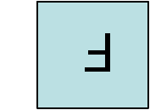
Convolution
Convolution:
Flip the filter in both dimensions (bottom to top, right to left)
Then apply cross-correlation
F
H
Notation for convolution operator

Slide 43
Convolution vs. correlation
Convolution
Cross-correlation
For a Gaussian or box filter, how will the outputs differ?
If the input is an impulse signal, how will the outputs differ?

Slide 44
Convolution
Convolution:
Flip the filter in both dimensions (bottom to top, right to left)
Then apply cross-correlation
F
H
Notation for convolution operator

Slide 45
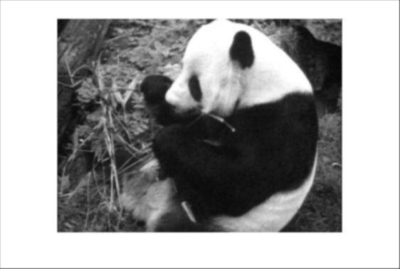
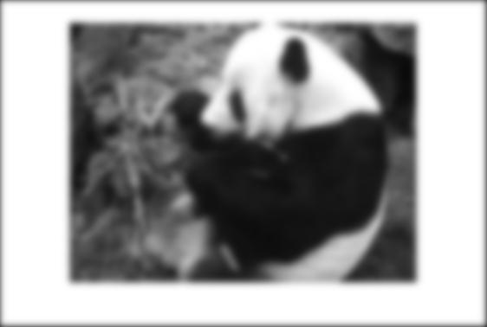
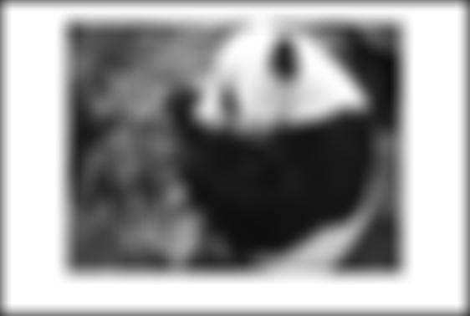
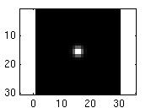
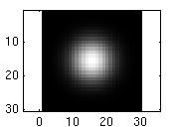
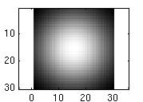
Smoothing with a Gaussian
Parameter σ is the “scale” / “width” / “spread” of the Gaussian kernel, and controls the amount of smoothing.
…
for sigma=1:3:10
h = fspecial('gaussian‘, fsize, sigma);
out = imfilter(im, h);
imshow(out);
pause;
end

Slide 46
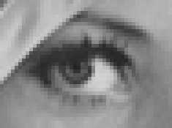
Convolving with linear filters
0
0
0
?
0
1
0
0
0
0
Original
Source: D. Lowe

Slide 47
Convolving with linear filters
0
0
0
0
1
0
0
0
0
Original
Filtered
(no change)
Source: D. Lowe

Slide 48
Convolving with linear filters
0
0
0
?
0
0
1
0
0
0
Original
Source: D. Lowe

Slide 49

Convolving with linear filters
0
0
0
0
0
1
0
0
0
Original
Shifted left
by 1 pixel with correlation
Source: D. Lowe

Slide 50
Practice with linear filters
1
1
1
?
1
1
1
1
1
1
Original
Source: D. Lowe

Slide 51

Practice with linear filters
1
1
1
?
1
1
1
1
1
1
Original
Blur (with a box filter)
Source: D. Lowe

Slide 52
Practice with linear filters
0
0
0
-
1
1
1
?
0
2
0
1
1
1
0
0
0
1
1
1
Original
Source: D. Lowe

Slide 53


Practice with linear filters
0
0
0
-
1
1
1
?
0
2
0
1
1
1
0
0
0
1
1
1
Original
Sharpening filter
Accentuates differences with local average
Source: D. Lowe

Slide 54


What does blurring remove?
Now let’s add it back……

Slide 55
Shift invariant linear system
Shift invariant:
Operator behaves the same everywhere, i.e. the value of the output depends on the pattern in the image neighborhood, not the position of the neighborhood.
Linear:
Superposition: h * (f1 + f2) = (h * f1) + (h * f2)
Scaling: h * (k f) = k (h * f)

Slide 56

Properties of convolution
Linear & shift invariant
Commutative:
f * g = g * f
Associative
(f * g) * h = f * (g * h)
Identity:
unit impulse e = […, 0, 0, 1, 0, 0, …]. f * e = f
Differentiation:

Slide 57
Separability
In some cases, filter is separable, and we can factor into two steps:
Convolve all rows
Convolve all columns

Slide 58

Separability
In some cases, filter is separable, and we can factor into two steps: e.g.,
h
What is the computational complexity advantage for a separable filter of size k x k, in terms of number of operations per output pixel?
g
f
f * (g * h) = (f * g) * h

Slide 59

Median filter
No new pixel values introduced
Removes spikes: good for impulse, salt & pepper noise

Slide 60

Median filter
Salt and pepper noise
Median filtered
Plots of a row of the image
Source: M. Hebert

Slide 61

Median filter
Median filter is edge preserving

Slide 62
Template Matching
via correlations and other related techniques

Slide 63
Template matching
Filters as templates:
Note that filters look like the effects they are intended to find --- “matched filters”
Use normalized cross-correlation score to find a given pattern (template) in the image.
Szeliski Eq. 8.11
Normalization needed to control for relative brightness.

Slide 64


Template matching
Template (mask)
Scene
A toy example

Slide 65

Template matching
Template
Detected template

Slide 66

Template matching
Detected template
Correlation map

Slide 67
Where’s Waldo?
Template
Scene

Slide 68

Where’s Waldo?
Template
Scene

Slide 69

Where’s Waldo?
Detected template
Correlation map

Slide 70


Template matching
Template
Scene
What if the template is not identical to some subimage in the scene?

Slide 71

Template matching
Template
Detected template
Match can be meaningful, if scale, orientation, and general appearance is right.

Slide 72

Template Matching

Slide 73

Comparing windows
Some possible measures include:

Slide 74

Correlations for comparing windows
If we are doing an exhaustive search over all image patches in the second image, this is cross-correlation of a template with an image.

Slide 75

Example
Note: this is a stereo pair from the NASA mars rover.
The rover is exploring the “El Capitan” formation.

Slide 76

Example

Slide 77

Raw cross-correlation

Slide 78

Example cont’d
Note that score image
looks a lot like a blurry
version of image 2.
This clues us in to the
problem with straight
correlation with an
image template.

Slide 79


Problem with raw correlations
Versus
Result is based on the brightness of the underlying image!

Slide 80
Solution
Subtract off the mean value of the template.
In this way, the correlation score is higher only
when darker parts of the template overlap darker parts of the image, and brighter parts of the template overlap brighter parts of the image.

Slide 81

Correlations – zero-mean template
Better! But highest score is still not the correct match.
Note: highest score IS best within local NN of correct match.

Slide 82

“SSD” or “block matching” (Sum of Squared Differences)
The most popular matching score.
We will use it when deriving Harris corners
Some researchers claim it works better than cross-correlation

Slide 83

Relation between SSD and Correlation

Slide 84

SSD

Slide 85

Handling intensity changes

Slide 86
Intensity normalization
When a scene is imaged by different sensors, or under different illumination intensities,, both the SSD and the C_{fg} can be large for windows representing the same area in the scene!
A solution is to NORMALIZE the pixels in the windows before comparing them by subtracting the mean of the patch intensities and dividing by the std.dev.

Slide 87

Intensity normalization

Slide 88

Normalized Cross Correlation

Slide 89
Normalized Cross Correlation
Important point about NCC:
Score values range from 1 (perfect match) to -1 (completely anti-correlated)
Intuition: treating the normalized patches as vectors, we see they are unit vectors. Therefore, correlation becomes dot product of unit vectors, and thus must range between -1 and 1.

Slide 90

Normalized Cross Correlation

Slide 91
Filters and Convolution - Crucial Points
A filter is a pattern of weights (<< ||image||)
Convolution applies the filter to the image
Output measures similarity between filter and image patch
only a rough estimate
Normalized correlation gives improved pattern detection

Slide 92
Slide Credits
Rob Fergus – NYU
Darell Trevor – UC Berkeley
Fei Fei Li - Stanford
Svetlana Lazebnik – UIUC
David A. Forsyth – UIUC
Robert Collins - PennState

Slide 93

Questions

